Slide 1
Naïve Bayes Classifier
by Deepika Pantola

Slide 2
Need of Naive Bayes Classifier
Medical Diagnosis: predict whether a person is suffering from diabetes based on his diet and daily workout.
Spam Classification: predict whether an email is spam or not.
Weather: predict whether it will rain tomorrow based on temperature, humidity, wind speed, etc.

Slide 3
Need of Naive Bayes Classifier
Relationship between features and the class variable is non- deterministic.
Need an approach to model probabilistic relationship between the features and class variable.

Slide 4
Naïve Bayes Classifier
Supervised form of learning.
A probabilistic framework to solve classification problems.
Works on Conditional probability.
Based on Bayes theorem.

Slide 5
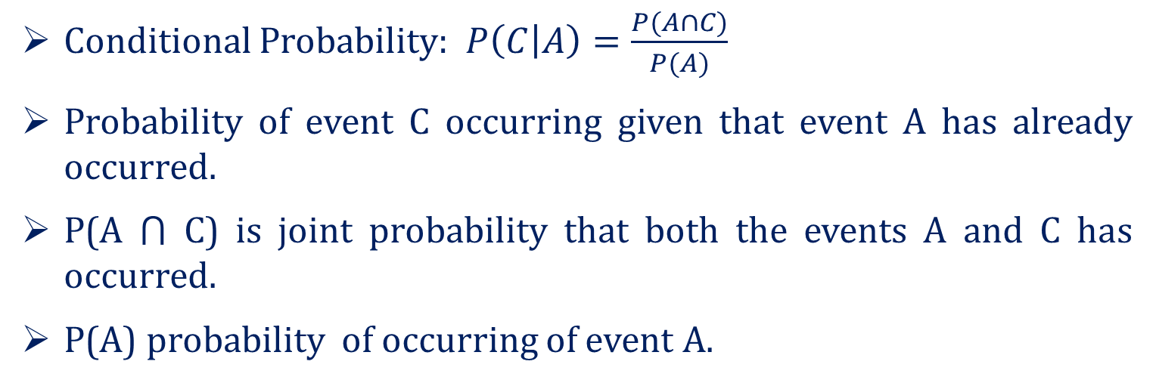
Conditional Probability
Conditional Probability: $P\left(C | A\right)=\frac{P(A∩C)}{P(A)}$
Probability of event C occurring given that event A has already occurred.
P(A ⋂ C) is joint probability that both the events A and C has occurred.
P(A) probability of occurring of event A.

Slide 6
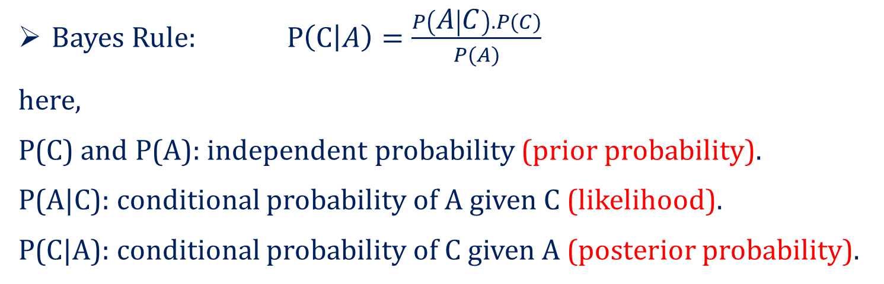
Bayes Theorem
Bayes Rule: $P\left(C | A\right)=\frac{P\left(A | C\right).P(C)}{P(A)}$
here,
P(C) and P(A): independent probability (prior probability).
P(A|C): conditional probability of A given C (likelihood).
P(C|A): conditional probability of C given A (posterior probability).

Slide 7
Example of Bayes Theorem
Given:
P(C): patient has liver disease, 10% of patients having liver disease.
P(A): patient is an alcoholic, 5% of patients are alcoholic.
P(A|C): probability that patient is alcoholic given that he has a liver disease, 7%.

Slide 8
Example of Bayes Theorem
Find out a patient’s probability of having liver disease if they are alcoholic.
According to Bayes theorem:
P(C|A)= (0.07*0.1)/0.05=0.14
Therefore, 14% chances of a patient having liver disease if they are alcoholic.

Slide 9
Naive Bayes Classifier
Consider each attribute and each class label as random variables.
Given a dataset D with attributes set A(A₁, A₂,…A_{n}) and class labels as C(C₁,…C_{m}). Let us given a record with attribute values:
Goal: predict class label C_{i}
Specifically, we want to find the value of C_{i} that maximizes P(C_{i}|A)

Slide 10
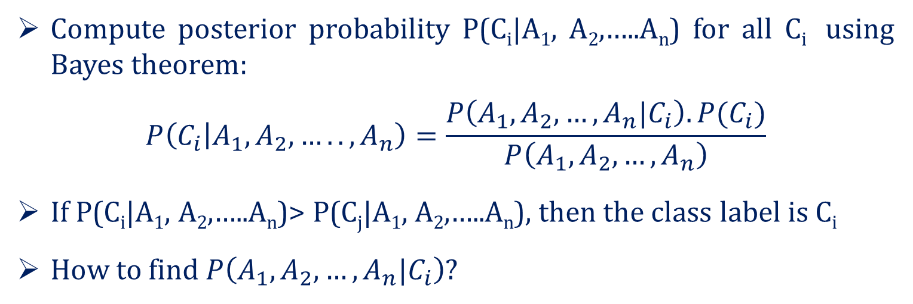
Naive Bayes Classifier
Compute posterior probability P(C_{i}|A₁, A₂,…..A_{n}) for all C_{i} using Bayes theorem:
$$P\left(C_{i} | A_{1},A_{2},…..,A_{n}\right)=\frac{P\left(A_{1},A_{2},…,A_{n}|C_{i}\right).P(C_{i})}{P\left(A_{1},A_{2},…,A_{n}\right)}$$
If P(C_{i}|A₁, A₂,…..A_{n})> P(C_{j}|A₁, A₂,…..A_{n}), then the class label is C_{i}
How to find $P\left(A_{1},A_{2},…,A_{n}|C_{i}\right)$?

Slide 11
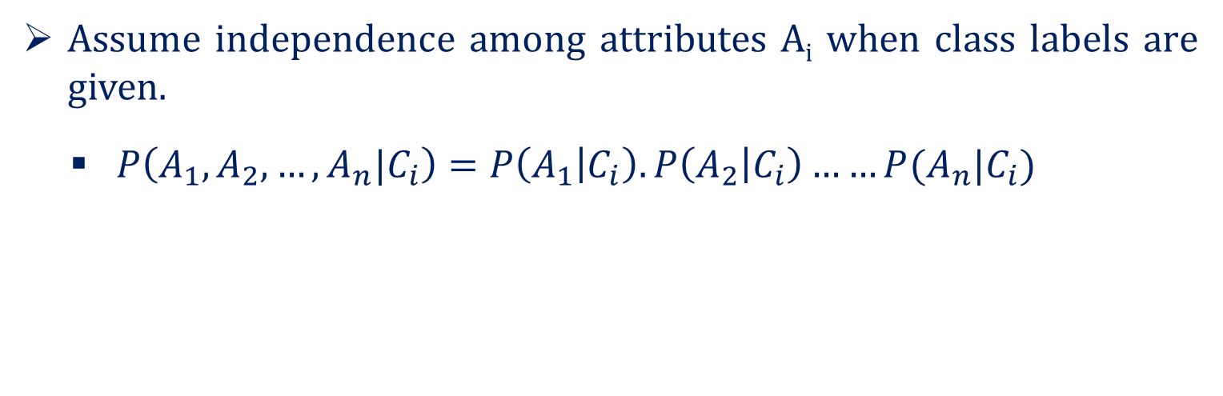
Naive Bayes Classifier
Assume independence among attributes A_{i} when class labels are given.
$P\left(A_{1},A_{2},…,A_{n}|C_{i}\right)=P\left(A_{1} | C_{i}\right).P\left(A_{2} | C_{i}\right)……P(A_{n}|C_{i})$

Slide 12
Working of Naïve Bayes Classifier
by Deepika Pantola

Slide 13

ID | Age | Income | Student | Credit_Rating | Buys_computer
1 | youth | high | no | fair | NO
2 | youth | high | no | excellent | NO
3 | middle | high | no | fair | YES
4 | senior | medium | no | fair | YES
5 | senior | low | yes | fair | YES
6 | senior | low | yes | excellent | NO
7 | middle | low | yes | excellent | YES
8 | youth | medium | no | fair | NO
9 | youth | low | yes | fair | YES
10 | senior | medium | yes | fair | YES
11 | youth | medium | yes | excellent | YES
12 | middle | medium | no | excellent | YES
13 | middle | high | yes | fair | YES
14 | senior | medium | no | excellent | NO

Slide 14
Naive Bayes Classifier Example
Given: tuple X <youth, medium, yes, fair, buys_computer=?>
Task: predict whether person X will buy computer?
Let us assume C₁ = YES and C₂ = NO
P(C₁) = 9/14 = 0.643 and P(C₂) = 5/14 = 0.357

Slide 15
Naive Bayes Classifier Example
To Compute P(X|C₁) and P(X|C₂), first compute following conditional probabilities:
P(youth|C₁) = 2/9=0.222
P( medium|C₁) = 4/9= 0.444
P(yes|C₁) = 6/9 =0.667
P(fair|C₁) = 6/9 =0.667
P(youth|C₂) = 3/5=0.600
P(medium|C₂) = 2/5=0.400
P(yes|C₂) = 1/5=0.2000
P(fair|C₂) = 2/5=0.400

Slide 16
Naive Bayes Classifier Example
P(X|C₁)=P(youth|C₁)*P(medium|C₁)* P(yes|C₁)*P(fair|C₁) = 0.222*0.444*0.667* 0.667 = 0.044
P(X| C₁).P(C₁) =0.044 * 0.643=0.028
P(X|C₂) = P(youth|C₂)* P(medium|C₂)* P(yes|C₂)*P(fair|C₂) = 0.600*0.400*0.200* 0.400 = 0.019
P(X| C₂).P(C₂)= 0.019 * 0.357= 0.007

Slide 17
Naive Bayes Classifier Example
Final class C_{i} is that maximizes P(X| C_{i}).P(C_{i})
P(X| C₁).P(C₁) > P(X| C₂).P(C₂), so tuple X class label is C₁

Slide 18
Types of Naïve Bayes Classifier
by Deepika Pantola

Slide 19
Types of Naïve Bayes Classifier
Naïve Bayes Classifier
Gaussian
Multinomial
Bernoulli

Slide 20
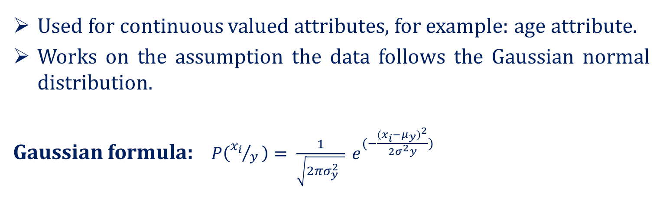
Gaussian Naïve Bayes Classifier
Used for continuous valued attributes, for example: age attribute.
Works on the assumption the data follows the Gaussian normal distribution.
Gaussian formula: $P\left({x_{i}}/{y }\right)= \frac{1}{\sqrt{2πσ_{y}^{2} }} e^{(−\frac{{{(x}_{i}−μ_{y})}^{2}}{{2σ}_{}^{2}y})}$

Slide 21
Multinomial Naïve Bayes Classifier
Mostly used for document classification problem.
For example: document belongs to the category of sports, politics, technology, etc.
The attributes used for classification are the frequency of the words present in the document.

Slide 22
Bernoulli Naïve Bayes Classifier
Similar to multinomial naïve bayes classifier.
But the attributes are boolean valued only .
For example: if a word occurs in a text yes or no.

Slide 23
Thank You

Slide 24
k-Nearest Neighbour Classifier
by Deepika Pantola

Slide 25
Eager Learners v/s Lazy Learners
Eager Learners: constructs generalization model based on training dataset before receiving new (e.g., test) tuples to classify.
Lazy Learners: simply stores the training dataset (or does only minor pre-processing) and waits until it is given a test tuple.
Lazy learners store the training tuples (or instances), also referred to as instance-based learners.

Slide 26
k- Nearest Neighbour Classifier
Simplest classification method.
Instance-based classifier.
Less time in training, more time in testing.
Based on learning by analogy- that is by comparing a given test tuple with training tuples that are similar to it.

Slide 27
k- Nearest Neighbour Classifier
k = 1, the unkown tuple is assigned the class label of the training tuple nearest to it.
When k= 3 or 5 ?
k =5
k =3
?

Slide 28
Closeness Measure
Euclidean Distance
Mahattan Distance

Slide 29
k-nn Classification Algorithm
Given k = number of nearest neighbours, D=training dataset.
1. for each test sample z=(x’, y’) do
compute distance between z and every sample point in D.
select k nearest neighbours of z.
return majority class label.
end for

Slide 30
Choosing the Value of k
If k is too small, sensitive to noise.
If k is too large, the neighbourhood may include points from other classes.

